Slide 1
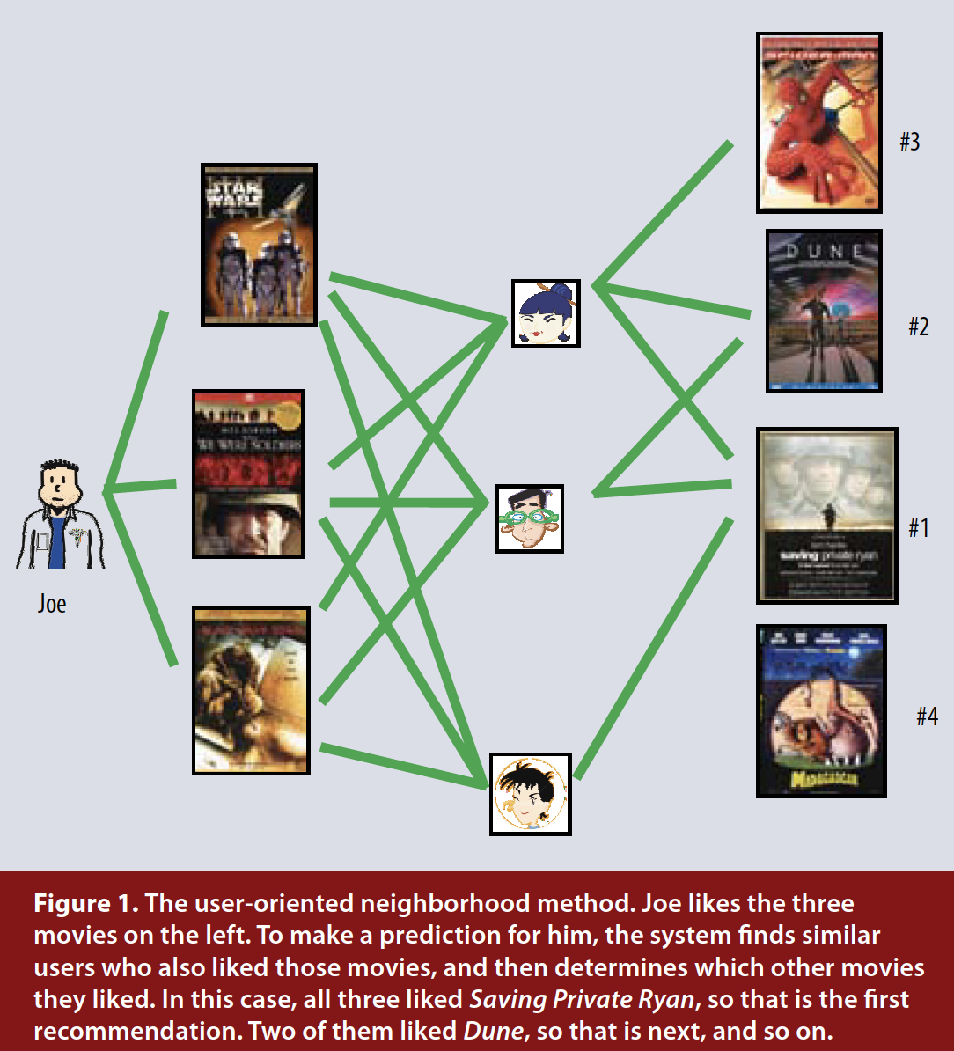
Collaborative Filtering
Overview:
Collaborative filtering analyzes relationships between users and interdependencies among products to identify new user-item associations. The collaborative filtering algorithm uses “User Behavior” for recommending items.

Slide 2
Advantage & Disadvantage
Advantage
A major appeal of collaborative filtering is that it is domain free, yet it can address data aspects that are often elusive and difficult to profile using content filtering.
Disadvantage
While generally more accurate than content-based techniques, collaborative filtering suffers from what is called the cold start problem, due to its inability to address the system’s new products and users. In this aspect, content filtering is superior.

